Slide 1
Module 2 – Leadership
Chapter 3 – Evaluation of Performance
Section 1 – Evaluation of Performance

Slide 2
Demonstrate knowledge of the challenge of leadership, the qualities of an effective leader, how to evaluate the performance of subordinates and how to give instruction

Slide 3
Define performance, ability, aptitude and achievement
Describe evaluation in the NJROTC
Explain goal-setting as it relates to self-evaluation
Explain progress assessment as it relates to self-evaluation
Describe the process of self-evaluation

Slide 4
Key Term Questions Slide Index
Click any link below to go directly to polling that question.
What a person does
Assessment regarding person’s performance
Potential skills and abilities in future
Assessment conducted after period of instruction
Looking at your progress, development, and learning
Click here to return to this index.

Slide 5
Team Assignment
Alpha
Bravo
Charlie
Delta

Slide 6
Refers to what a person does; actual behavior or actual output
Progress assessment
Self-evaluation
Performance
Self-confidence
1
1
1
1
(NS3-M2U1C3S1:KT1)

Slide 7
An assessment, appraisal, rating, or judgment regarding a person’s performance
Aptitude
Performance
Judgment
Evaluation
1
1
1
1
(NS3-M2U1C3S1:KT2)

Slide 8
Potential skills and abilities in the future
Aptitude
Performance
Ability
Disposition
1
1
1
1
(NS3-M2U1C3S1:KT3)

Slide 9
Assessment that is conducted after a period of instruction; in the military, it is measured by periodic formal and informal: performance ratings, advancement exams, aptitude tests
Mental assessment
Progress assessment
Ethical assessment
Character assessment
1
1
1
1
(NS3-M2U1C3S1:KT4)

Slide 10
Looking at your progress, development, and learning to determine what has improved and what areas still need improvement
Performance evaluation
Progress assessment
Skill assessment
Self-evaluation
1
1
1
1
(NS3-M2U1C3S1:KT5)

Slide 11
Performance -
Refers to what a person does – actual behavior or actual output
Evaluation -
An assessment, appraisal, rating, or judgment regarding a person’s performance
Aptitude -
Aptitude refers to potential skills and abilities in the future

Slide 12
Progress assessment -
Assessment that is conducted after a period of instruction; in the military, progress is measured by periodic formal and informal: performance ratings, advancement exams, aptitude tests
Self-
evaluation -
Looking at your progress, development and learning to determine what has improved and what areas still need improvement

Slide 13
What is self-evaluation and why is it important?
1.
2.
3.
Note to Instructors:
Click the Show/Hide Response Display Button

Slide 14
What would you say is your one biggest motivator?
Recognition - I love earning awards, respect, and notoriety.
Influence - I want power, control, and independence.
Internal - I have a voice inside my head that drives me to do the right thing.
Profit - Show me the money!
1
1
1
1
(NS3-M2U1C3S1:LQ1)

Slide 15
One of the most important responsibilities of leaders is properly evaluating the ______ of their subordinates.
ability
achievements
aptitude
performance
1
1
1
1
(NS3-M2U1C3S1:LQ2)

Slide 16
Introduction
Selection of Personnel
In the Navy and in NJROTC, officers are concerned with the selection of personnel for:
Serving as instructors
Receiving of school nominations
Advancing in rate
Filling billets in the unit
Carrying out specific assignments

Slide 17
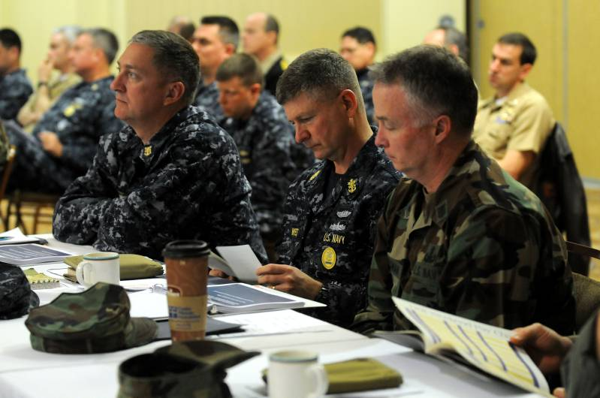
Introduction
Judgment of Capability
The overall performance rating of a naval leader is greatly affected by his/her ability to:
Select appropriate people for various roles
Judge their capability to take on future assignments of greater responsibility

Slide 18
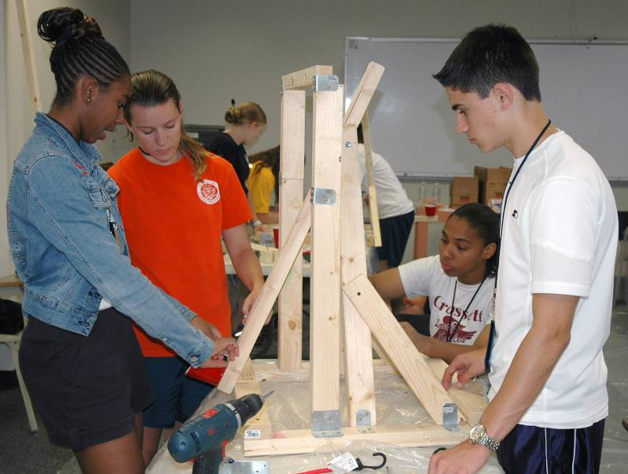
Performance, Ability, Aptitude,
Achievement
Performance versus Ability
Performance refers to what a person does – actual behavior or actual output.
Ability often applies to:
Performance over a considerable period of time
What a person could do at a given moment, if the situation were right

Slide 19
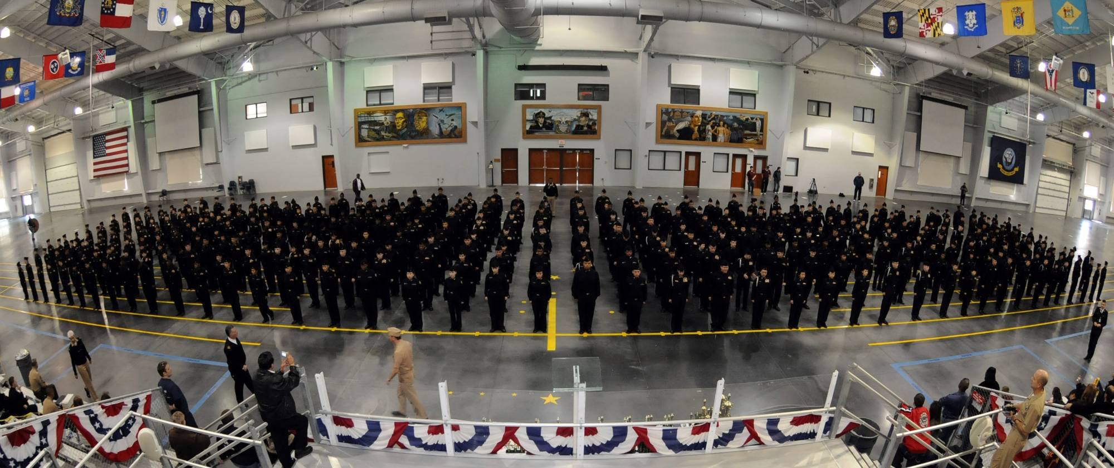
Performance, Ability, Aptitude,
Achievement
It is the Results that Count!
In the final analysis, ability cannot be judged except by observing performance.

Slide 20
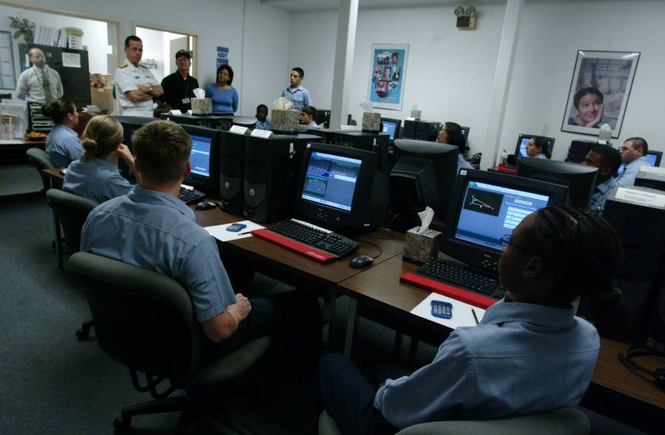
Performance, Ability, Aptitude,
Achievement
Aptitude
Both performance and ability refer to the present - what the person can do now.
Aptitude refers to potential skills and abilities in the future.

Slide 21
Performance, Ability, Aptitude,
Achievement
Aptitude
Two examples of aptitude tests are the SAT (Scholastic Aptitude Test) and the ASVAB (an armed services aptitude test).
Aptitude tests as well as background experiences can be used to select individuals for training in certain areas.

Slide 22
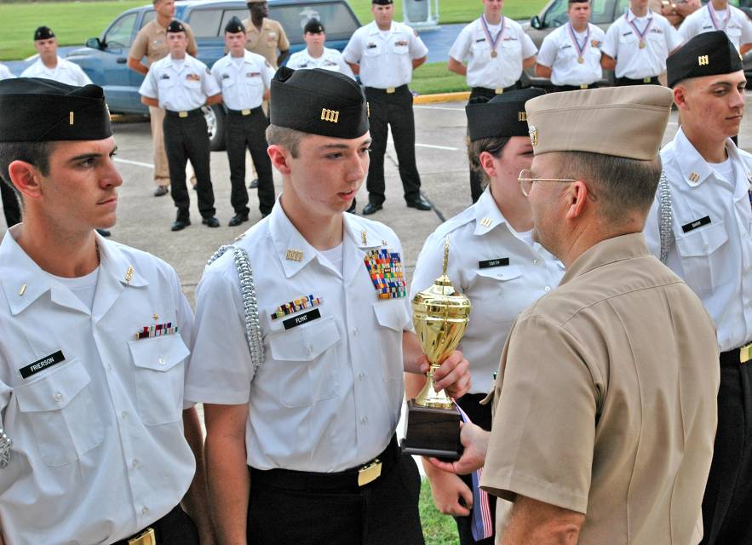
Performance, Ability, Aptitude,
Achievement
Achievement
Achievement generally refers to performance in the past, often that which has already been evaluated.
Achievement applies to work that has been done.

Slide 23
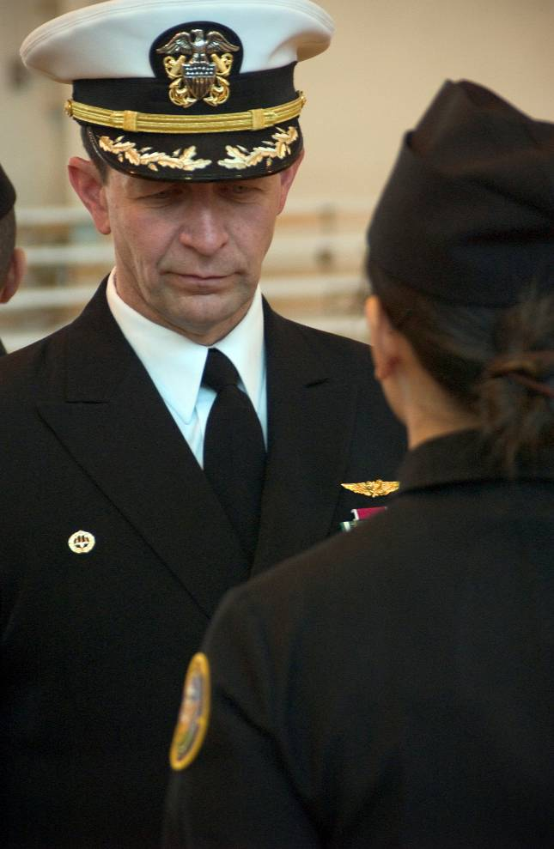
Performance, Ability, Aptitude,
Achievement
Usefulness of Achievement in Evaluation
When properly evaluated, past achievements can be used to select people for promotion or future job assignments.
Properly evaluating the achievements of their subordinates is one of the most important responsibilities of a leader.

Slide 24
Performance, Ability, Aptitude,
Achievement
Achievement
(Past)
Performance
(Present)
Aptitude
(Future)
Ability
(Potential Present)

Slide 25
As a unit team commander, learning to evaluate the cadets under you is important to ______ the team and help you to be a ______ leader.
improve; laid back
aggravate; nicer
benefit; better
maintain; stronger
1
1
1
1
(NS3-M2U1C3S1:LQ3)

Slide 26
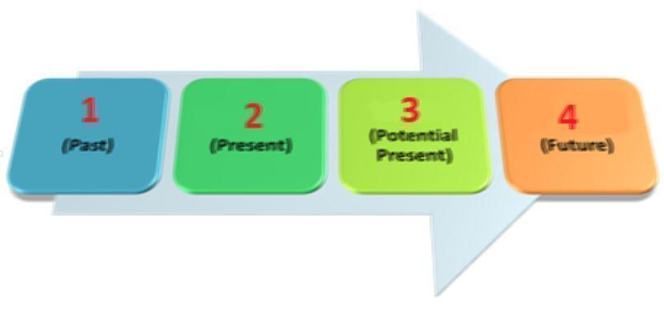
Choose the answer that correctly completes the diagram.
1) Achievement; 2) Ability; 3) Performance; 4) Aptitude
1) Performance; 2) Achievement; 3) Aptitude; 4) Ability
1) Achievement; 2) Performance; 3) Ability; 4) Aptitude
1) Aptitude; 2) Ability; 3) Performance; 4) Achievement
1
1
1
1
(NS3-M2U1C3S1:LQ4)

Slide 27
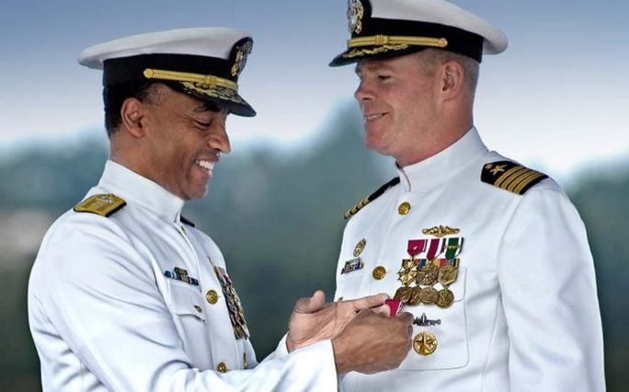
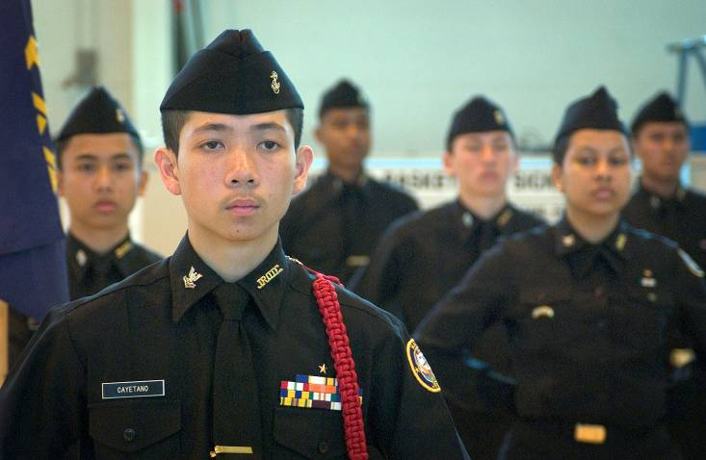
Evaluation in the NJROTC
NJROTC Objectives
Developing leadership ability is one of the main objectives of NJROTC.

Slide 28
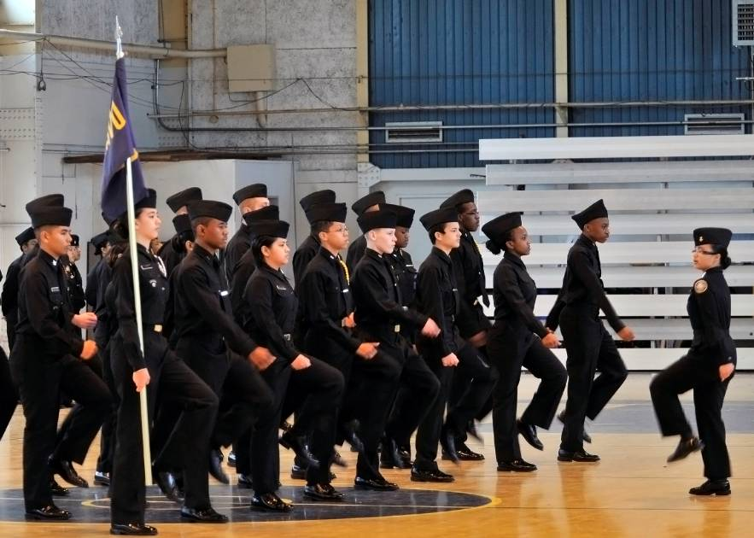
Evaluation in the NJROTC
Expectations
You should strive to become a leader in your:
School
Unit
Community
You should prepare for higher leadership roles later in life.

Slide 29
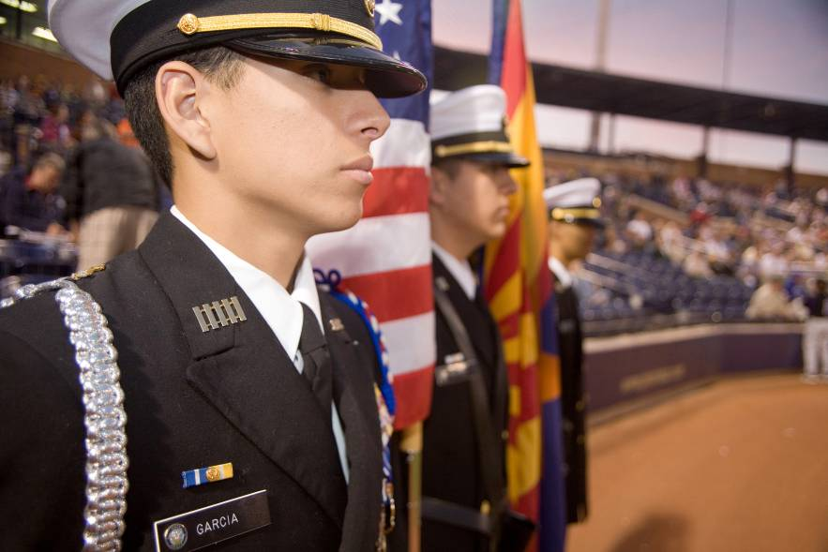
Evaluation in the NJROTC
Nomination
Current officers and instructors must evaluate and nominate their successors at some time during the school year.

Slide 30
Evaluation in the NJROTC
Evaluations of Prospective NJROTC Officers
Basis of Evaluations
Positive End Results
Character
Honesty
Motivation
Academic effort and success
Cooperation in unit
Record of loyalty
Appearance in uniform
Leaders’ recommendations
Awards
Advancements
Promotions

Slide 31
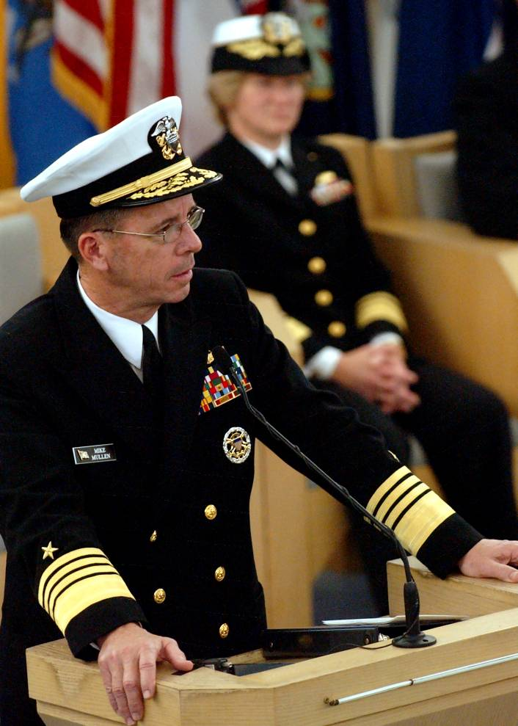
Evaluation in the NJROTC
A System that Works
Sound evaluation grounded in sound personal leadership is the key to success.

Slide 32
What is one of the main objectives of NJROTC?
Winning wars
Differentiating from other branches
Creating obedient followers
Developing leadership ability
1
1
1
1
(NS3-M2U1C3S1:LQ5)

Slide 33
In evaluating the sailor, based on the statement below, which of the following characteristics would you say this evaluation most strongly exemplifies? Managed removal of flight deck debris, fuel, oil, hydraulic fluids, and other hazards; kept flight deck operational despite 50% reduction in equipment availability; ensured zero delays to flight deck operations
Honesty
Motivation
Academic record
Record of loyalty
1
1
1
1
(NS3-M2U1C3S1:LQ6)

Slide 34
Self-Evaluation
Self-Evaluation is for Everyone
It is not necessary for a person to wait until a formal evaluation time or period to evaluate his or her own performance.
Everyone should go through a periodic self-evaluation process.

Slide 35
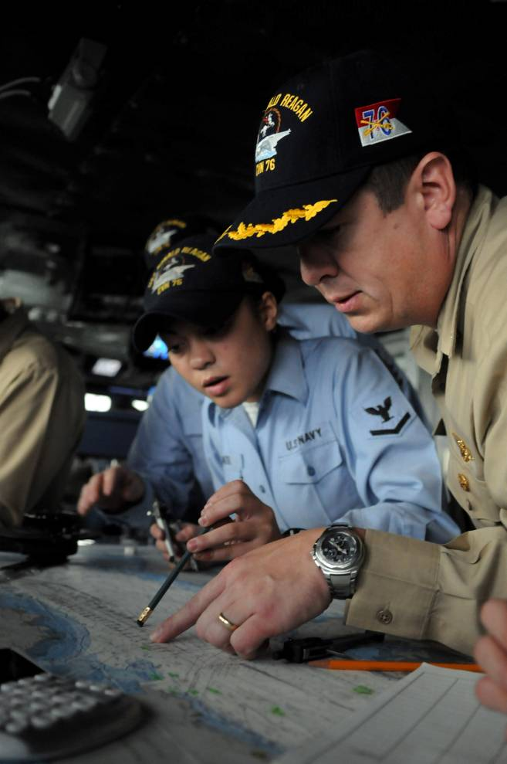
Self-Evaluation
You are the Navigator of Your Life
Think about:
Where you have been
Where you are
Where you are going
How to get there
Do you know if you are on the correct course to your destination?

Slide 36
Self-Evaluation
Setting Goals
Success is reached by setting realistic and attainable goals.
The more difficult and complex your goal is, the more subgoals are necessary to achieve ultimate success.
Think of subgoals as milestones to reach on your journey to your overall goal.

Slide 37
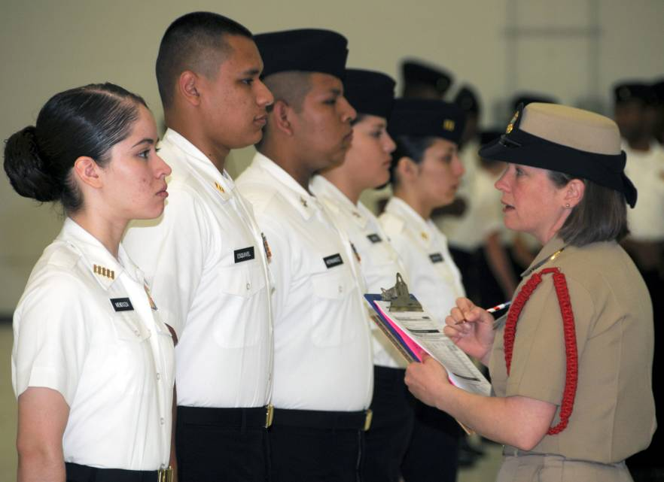
Self-Evaluation
Military Measurement of Progress
Once realistic goals have been set, the next step is to assess the progress towards them.
In the military, progress is measured by periodic formal and informal:
Performance ratings
Advancement exams
Aptitude tests

Slide 38
Self-Evaluation
Continually Self-Evaluate
Continually self-evaluate by frequently asking yourself:
How well am I progressing toward my goal?
Am I off track?
Is corrective action required to get back on track?

Slide 39
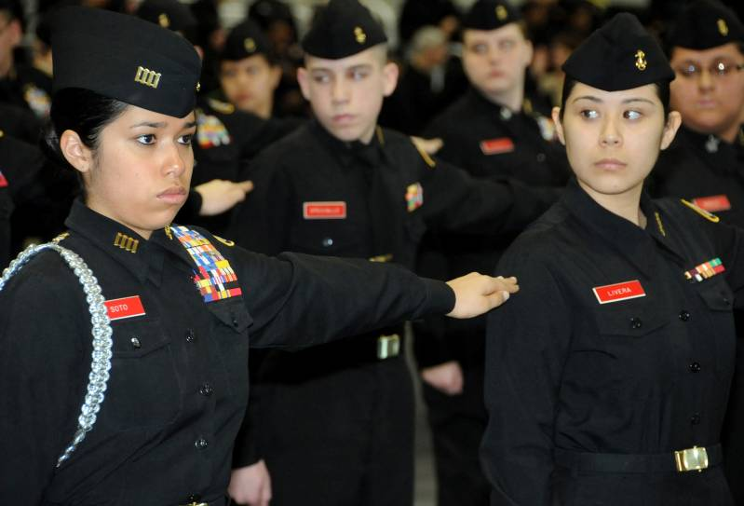
Self-Evaluation
Staying on Track
It is much easier to stay on course toward a goal by making periodic small corrections than it is to make a large correction only once or twice along the way.

Slide 40
Self-Evaluation
The Main Tasks in any Self-Evaluation Process
The main tasks to accomplish during any self-evaluation process are:
Set realistic criteria
Make realistic assessments
Be truly honest with yourself
Change behavior as often as needed

Slide 41
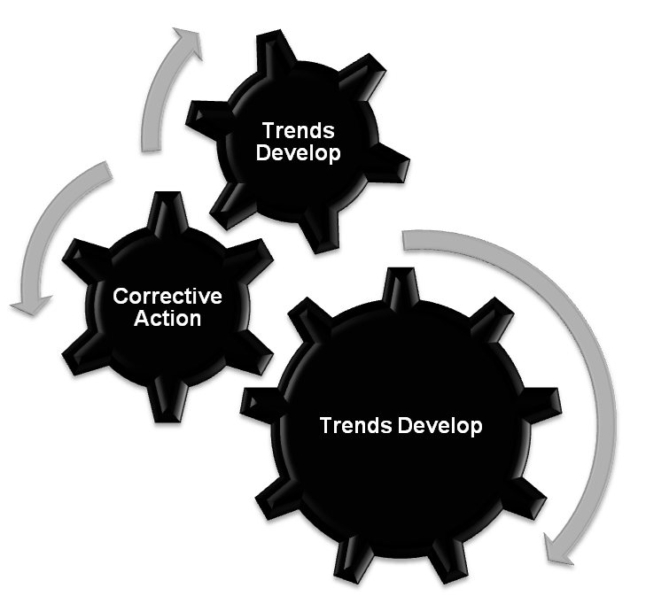
Self-Evaluation
NJROTC, Navy, Civilian Life
You must steadily grow personally and professionally in order to succeed in any organization.
This is done by:
Setting short-term and long-term goals in each area of concern
Taking appropriate corrective action
Restarting the process

Slide 42
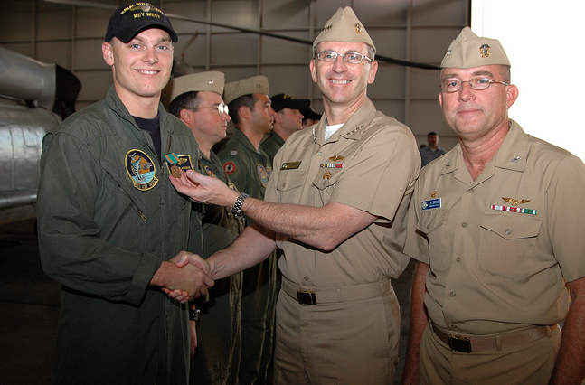
Self-Evaluation
Get the Most Out of Life
Ultimately, you can get the most out of life by achieving your major long-term personal and professional objectives.

Slide 43
Describe the basis by which an NJROTC cadet is evaluated.
1.
2.
3.
Note to Instructors:
Click the Show/Hide Response Display Button

Slide 44
Success is reached by setting ______ goals.
realistic
unreachable
many complex
easily achievable
1
1
1
1
(NS3-M2U1C3S1:LQ7)

Slide 45
Which of the following questions would be effective for continual self-evaluation? (Input all that apply, then push the ENTER button.)
How well am I progressing toward my goal?
How are my peers progressing?
Am I off track?
Do I need to take action to get back on track?
1
1
1
1
(NS3-M2U1C3S1:LQ8)

Slide 46
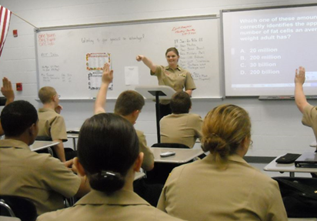

Slide 47
Leaderboard
Last
Slide
Points | Participant | Points | Participant

Slide 48
Team Scores
Last
Slide
Points | Team | Points | Team

Slide 49
Team MVP
Last
Slide
Points | Team | Participant

Slide 50
Whiteboard
Last
Slide

